Slide 1


VERIDOX
Team-13 , PS -76
25MVCSMR0284 – B Shreshtha
25MVCSMR0275 – A Kusuma
25MVCSMR0318 – K Likhitha
25MVCSMR0297 – Ch Surya Teja Sree
DIGITAL DOCUMENT VERIFICATION
Notes:
Open with the promise: VERIDOX turns document checks into evidence people can inspect and decisions teams can defend. Use the mesh as the visual metaphor for signals becoming a trusted surface.

Slide 2

THE TRUST GAP
Documents are easy to alter. Trust is hard to recover.
Forged certificates and edited PDFs can look convincing at a glance. Manual checking is inconsistent, slow, and difficult to audit.
When verification stalls, decisions stall too: in education, hiring, finance, insurance, and public services.
A convincing edit can still hide a consequential inconsistency.
Notes:
Frame the problem as a trust-recovery problem, not simply a fraud problem. Point from the altered certificate to the blocked decision, then explain why an auditable evidence trail matters.

Slide 3
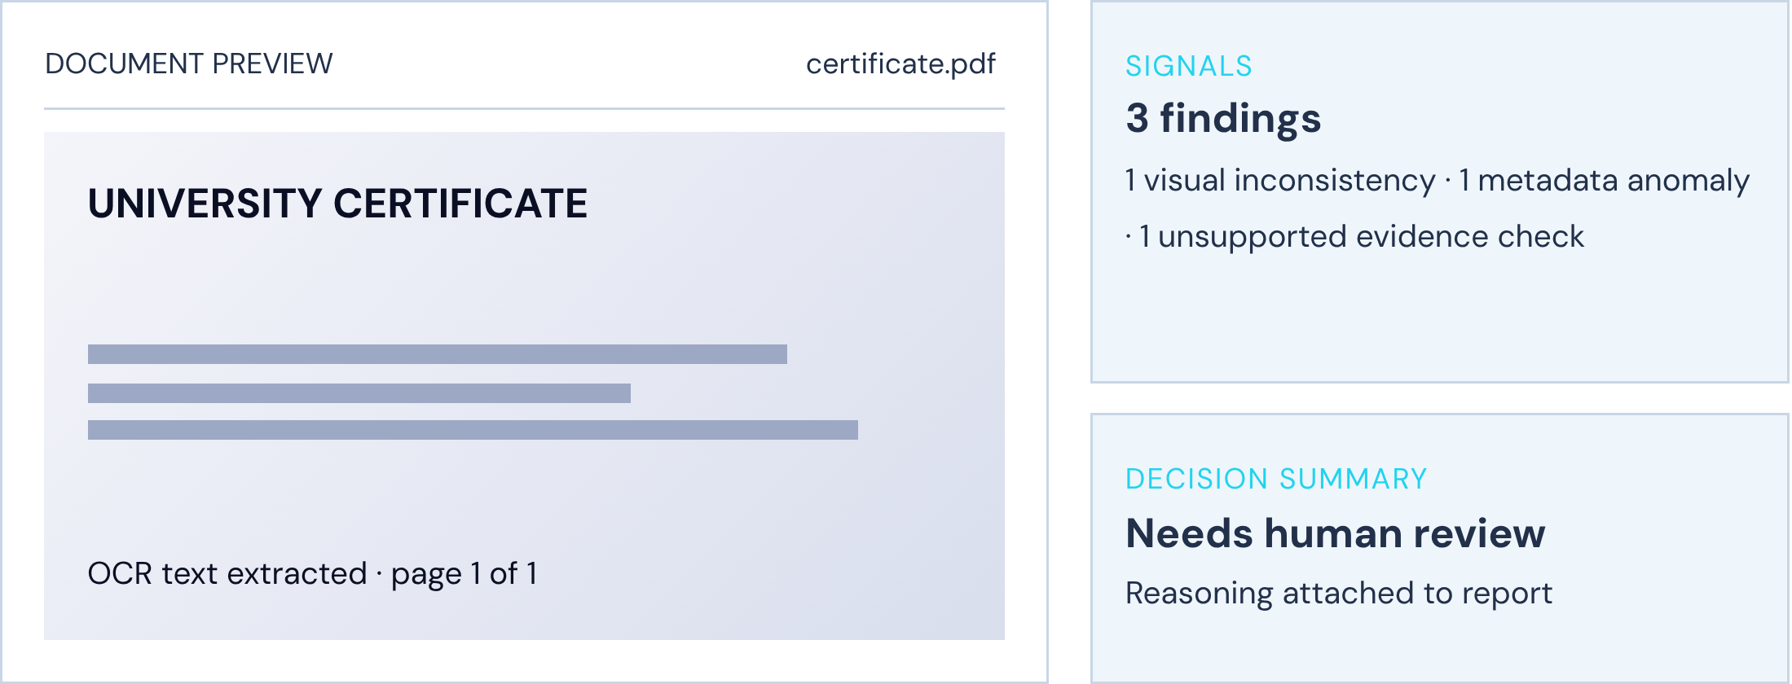



THE VERIDOX WORKSPACE
One workspace for evidence-based verification
Bring the document, its signals, the reviewer’s decision, and the final report into one reviewable flow.
Submit
Inspect
Upload and extract text.
Review structure, metadata, and signals.
Decide
Record a human outcome and report.
Notes:
Show VERIDOX as a working surface, not a black box. Move left to right through the document, the signal panel, and the decision summary that becomes a report.

Slide 4
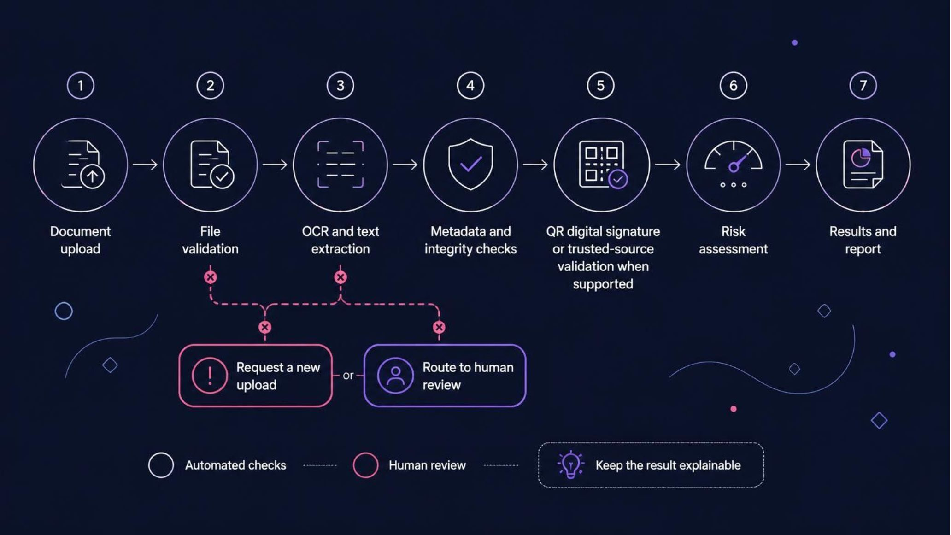
THE VERIFICATION PIPELINE
From submission to explainable result
Every result carries the path that produced it. Unsupported or unreadable files branch to a new upload request or human review.
Notes:
Trace one document through the pipeline. Emphasise that failure is handled explicitly: an unreadable or unsupported file does not become a misleading score, it becomes a new upload request or a human-review route.

Slide 5
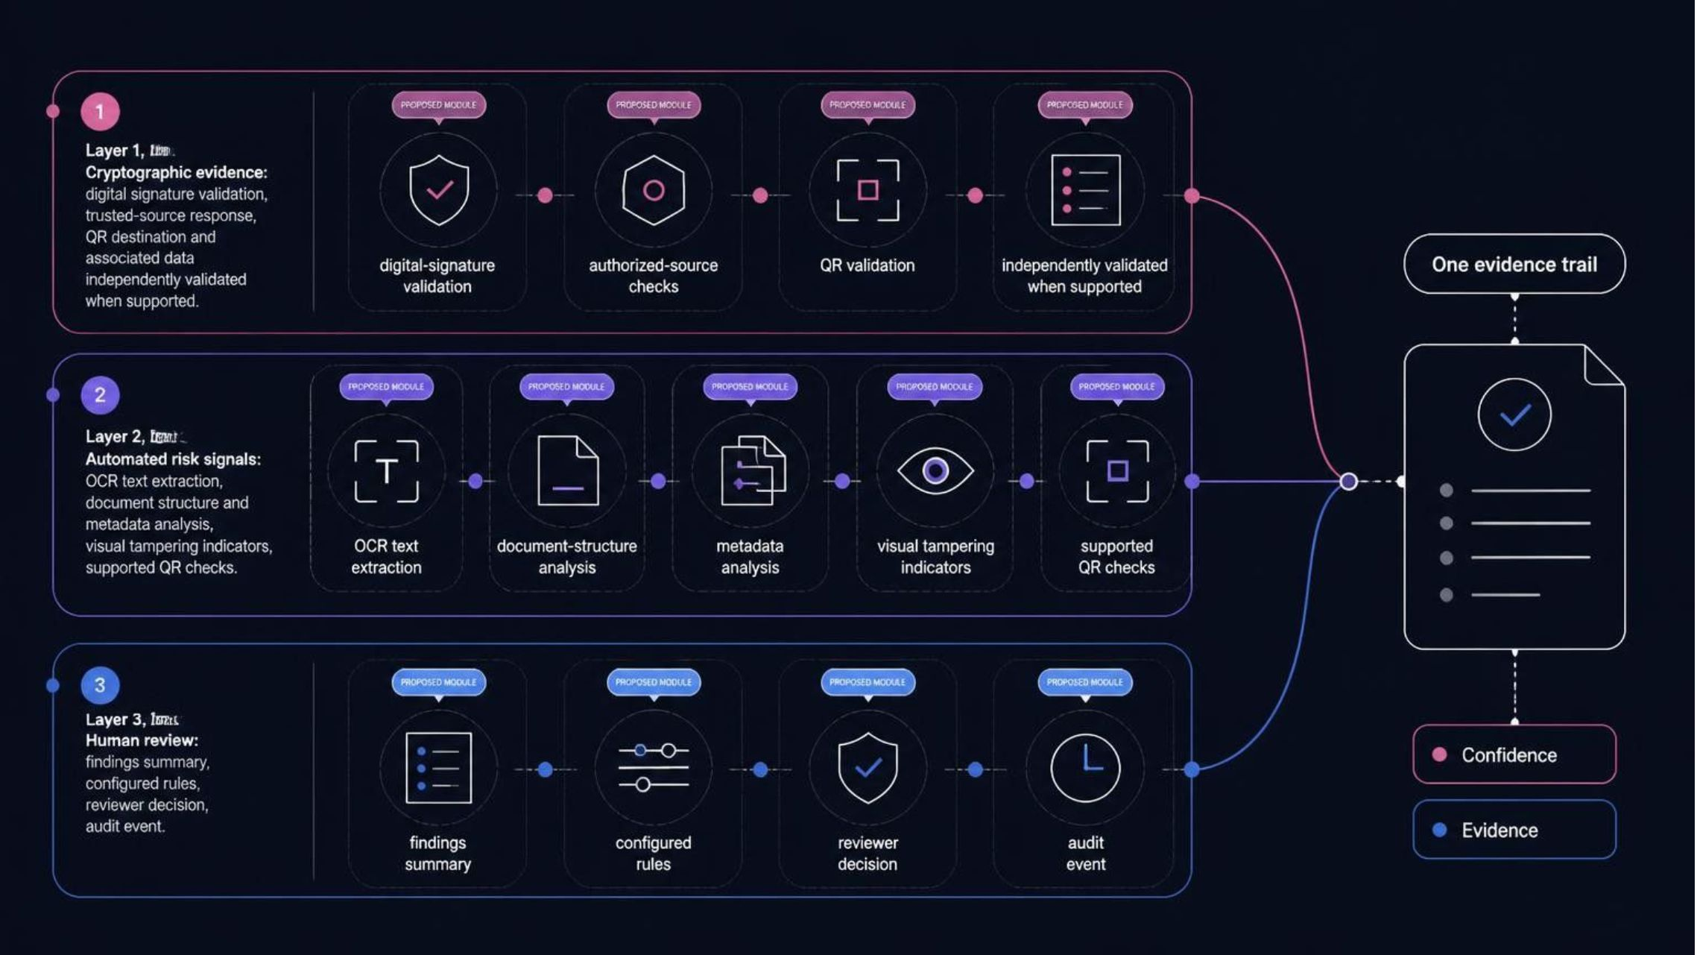
EVIDENCE, NOT A SINGLE SCORE
Multiple signals. One evidence trail.
VERIDOX separates what is cryptographically supported, what automation observes, and what a reviewer decides.
Notes:
Use the three lanes to establish credibility. A cryptographic result is different from an automated risk signal, and both are different from a human decision. The report preserves those distinctions.

Slide 6
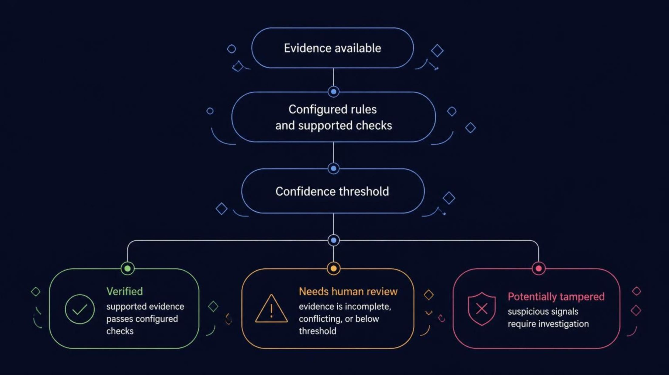
THE DECISION MODEL
Verification is a decision aid, not a magic stamp.
Evidence available → configured rules → confidence threshold → next action. VERIDOX never guarantees authenticity on its own.
Notes:
Pause on the three outcomes. “Verified” means supported evidence passed configured checks, not that a machine has proved authenticity. The other two outcomes make uncertainty visible and actionable.

Slide 7
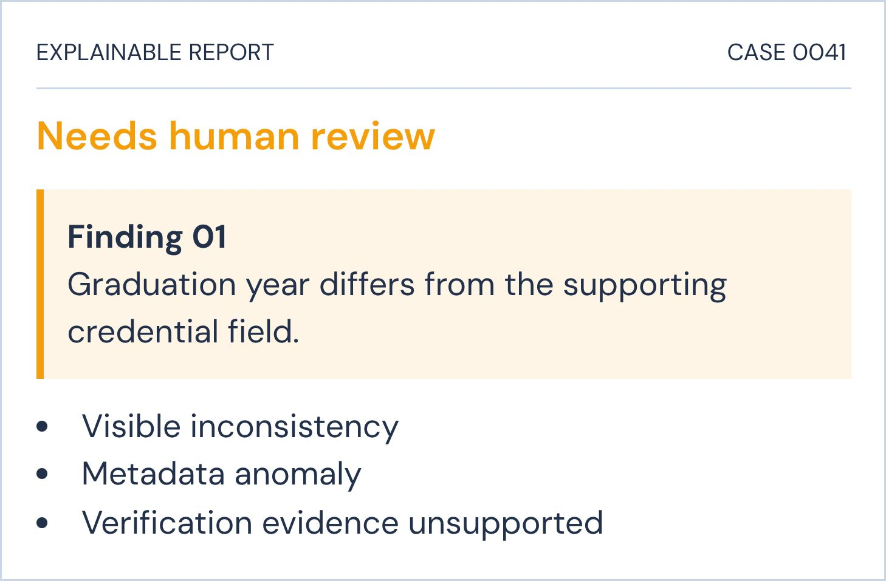
ILLUSTRATIVE CASE · FICTIONAL UNIVERSITY CERTIFICATE
One edited field changes the review
Compare an original-looking certificate with a deliberately modified graduation year or credential field.
ORIGINAL-LOOKING
DELIBERATELY MODIFIED
Graduation year
2024
Graduation year
2027
The output names the signal, the uncertainty, and the next action.
No visible inconsistency in this illustrative view.
Visible inconsistency flagged for investigation.
Illustrative only. No real institution or real result is implied.
Notes:
Make the example concrete while keeping the boundary clear: this is fictional and illustrative. A single edited field changes the review outcome because the report shows the inconsistency and why human investigation is needed.

Slide 8
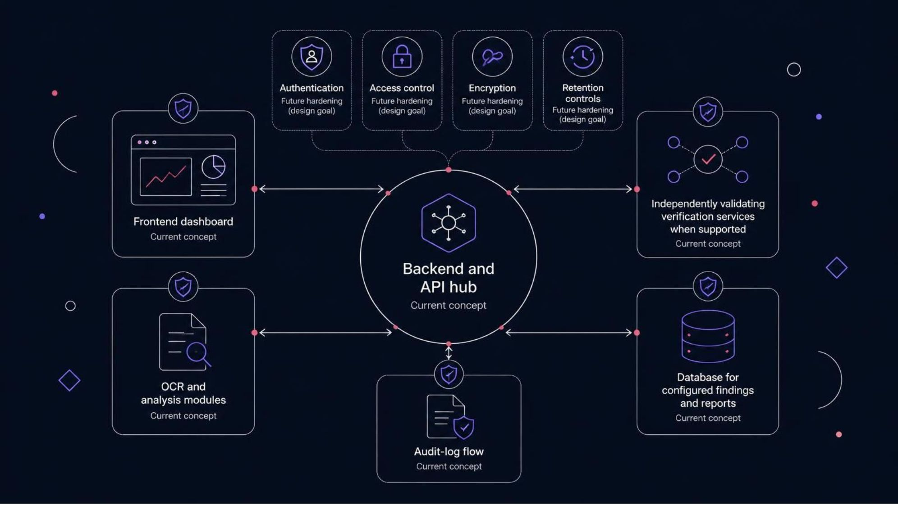
CONCEPT ARCHITECTURE
Modular architecture with security by design
The current concept separates the review surface from analysis modules, verification services, storage, and audit events. Future hardening is labeled, not assumed.
Notes:
Separate what the concept already demonstrates from what the production system must harden. Point to the trust boundaries, then to the audit-log flow that makes actions reviewable after the decision.

Slide 9





THE SCALE PATH
Start with verification. Scale into trusted workflows.
Who benefits
Now → next → later
Now
Later
Inspect documents, surface evidence, support verification checks, and produce reports.
Scalable processing and advanced fraud analysis for repeatable workflows.
Universities
HR teams
Banks
Insurers
Next
Public services
Trusted-source integrations, broader signature and QR coverage, configurable policies.
Benefits: faster triage, clearer evidence, repeatable workflows, and stronger auditability without unsupported numerical promises.
Notes:
Position the roadmap as a disciplined scale path. Start with the capability demonstrated in the concept, then expand coverage and policy configuration before claiming advanced automation.

Slide 10
VERIDOX · EVIDENCE-BASED VERIFICATION
Trust Every Document.
From document submission to evidence-based verification, build trust into every digital workflow.
VERIDOX turns scattered checks into a transparent, reviewable process.
Demo Link: https://veri-gbul4m5zl-shreshtha7.vercel.app/
✓ VERIFIED
Notes:
Close on the identity and the practical promise. VERIDOX does not replace judgment; it makes evidence, uncertainty, and decisions visible enough to trust.

